Slide 1
Lucinda Jetty Remediation
The access decision
Board briefing | Sugar Terminals Limited | August 2026
ED-018-2026-03 | Rev B | 20 August 2026 | Prepared: S Kurien | Checked and approved: J van Iersel
Prepared by Endura Decommissioning under engagement ED-018-2026-01. Commercial in confidence.

Slide 2
One number decides this project
To finish the priority scope by the end of 2028, the works must complete 4.5 pilebents every week.
0.36
2.5
4.5
per week achieved
per week planned
per week required
March to July 2026
the contract programme
to finish by end 2028
The plan was half the required rate before a single day was lost. Delivery is running at one twelfth. At the achieved rate the remaining 227 pilebents finish beyond 2035 on that arithmetic; the asset requirement is the end of 2028. A pilebent is one of the repeating two pile frames that carry the jetty; 227 bent planning basis, pending the STL register.
Commercial in confidence | Endura Decommissioning | ED-018-2026-03 | Rev B
2

Slide 3
More effort cannot fix it
The constraint is built into how access is provided, not into how hard anyone works.
Today, scaffold is built, wrapped, stripped and rebuilt at every single pilebent. Of a 15 to 16 day cycle, only about half is trade work; the rest is access handling and approval waiting, paid again 227 times. To reach 4.5 per week this way would take 14 to 18 scaffold crews working at once. The method physically supports about five: one welding unit, one blasting unit, and a single lane roadway that every scaffold movement must share. Five perfect scaffold fronts deliver 1.3 to 1.7 per week. That is five or more seasons of work, whoever performs it.
Needed: 14 to 18 (16 shown). Re tendering the same method hands the same arithmetic to the next contractor.
Commercial in confidence | Endura Decommissioning | ED-018-2026-03 | Rev B
3

Slide 4
The fix: build the access once, and move it
A floating work platform replaces the scaffold that is currently rebuilt at every pilebent.
1
Platforms float in by boat
Work stages built on floats are pushed to each pilebent by workboat and joined around the piles. Reduced roadway load.
What does not change
The trade work itself. Same repairs, same coating system, same crews, same rates, same quality standard. This assessment re prices the access only. What improves is that the trade crews always have a face to work on, instead of waiting for scaffold.
2
They lift clear of the tide
Electric hoists raise the whole stage above the water, where it is secured as a stable, enclosed work deck.
3
The trades work, then it moves on
Welding, blasting, coating and wrapping happen exactly as they do today. Then the platform moves to the next pilebent in hours, not days.
The system uses suspended access equipment already certified and working under jetties of this kind, sized here into a fleet.
Commercial in confidence | Endura Decommissioning | ED-018-2026-03 | Rev B
4

Slide 5
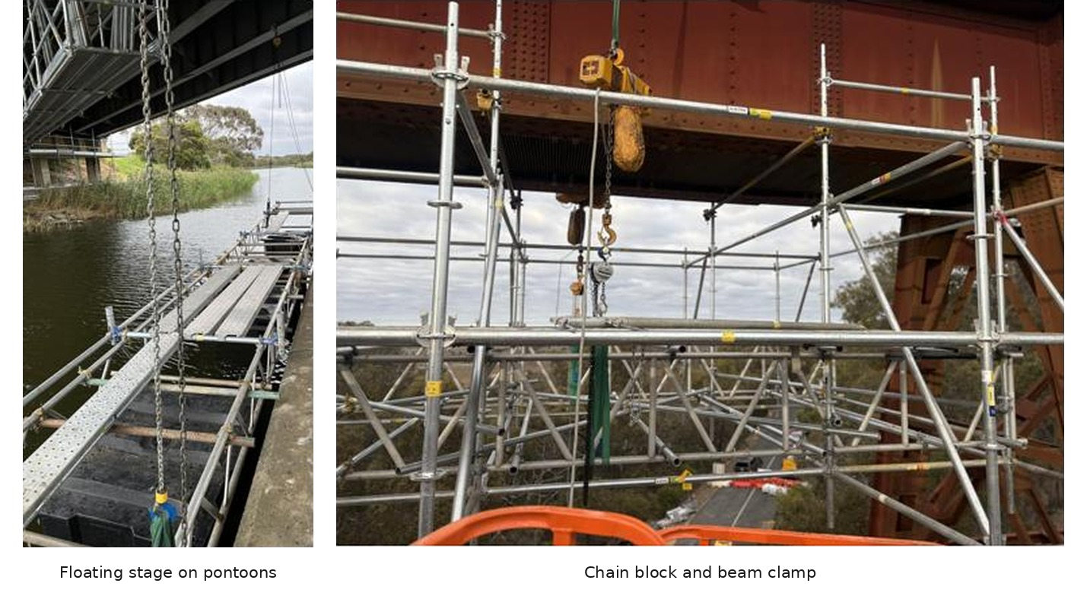
The kit exists: supplier platforms in service

Slide 6
Two ways to run it
Same platform system, same trade work. The difference is when the trades work.
Option 1 Recommended, day shift
Option 2 Retained, pending approvals
All work in daylight. Platforms move and trades work in the same six day week.
Trades also work at night on the secured platform. All boat moves and lifting stay in daylight.
Work platforms operating
8
Work platforms operating
5
People on the water or jetty
about 51
People on site, two shifts
about 59
Access cost
$16.04M
Access cost
$14.22M
Completion
Oct 2028
Completion
Oct 2028
STL advised on 21 August 2026 that night work is not currently available and is enquiring on the approval requirements, so Option 2 stays live. Its compressed day pattern runs both trade shifts inside 0600 to 2200 on six fronts at about $13.95M; the 1800 to 2200 noise limit equals the daytime limit, so the ask shrinks from night work to evening work in a lit, enclosed habitat.
Commercial in confidence | Endura Decommissioning | ED-018-2026-03 | Rev B
5

Slide 7
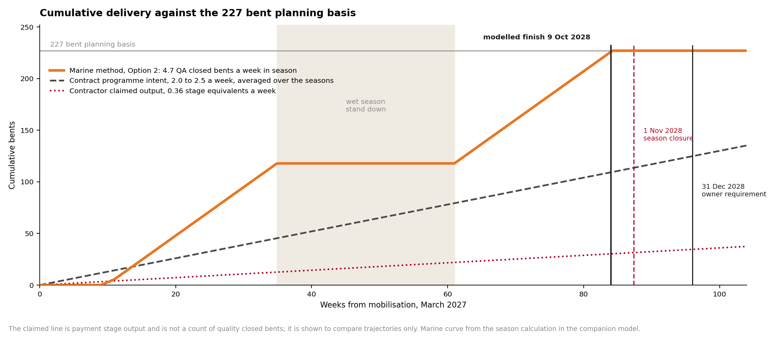
Delivery trajectory against the deadline

Slide 8
Why Option 1 is the recommended case
Weather on this coast is the one input no study can pin down in advance.
Option 1 needs eight, nine or ten platforms depending on how the weather lands. The fleet must be ordered before anyone knows. Option 2 needs six, in almost every case. Working the trades day and night halves the time each pilebent is exposed to the weather, so bad seasons cost days, not extra vessels. Fewer platforms also means less new equipment to fabricate before a March 2027 start, the tightest lead time in the programme. The compressed day pattern, both shifts inside 0600 to 2200, captures most of this at six fronts without entering the night band.
A commitment that holds still when the weather is known is worth more than a cheaper one that moves.
Commercial in confidence | Endura Decommissioning | ED-018-2026-03 | Rev B
6

Slide 9
What the outcome costs
Compared like for like: access provision against access provision. The trade works are identical on both sides.
$6.8M more
for the recommended day shift case is the difference between finishing beyond 2035 on that arithmetic and finishing in October 2028. If extended hours are approved it falls to $5.0M.
1.7 times the access provision on day shift, 1.5 with extended hours, for thirteen times the claimed stage output.
Buys 0.36 stage equivalents per week
Finish beyond 2035 on that arithmetic
Buys 4.5 to 5.1 per week
Finish October 2028
Screening estimates with 25 percent contingency; an estimate class is claimed at the controlled basis of estimate (HP8). Excludes platform fabrication, insurances, permits, port charges, accommodation and escalation, each identified for pricing at the next stage. Current method figure is derived from the priced schedule: safe access line items total $9,242,779.
Commercial in confidence | Endura Decommissioning | ED-018-2026-03 | Rev B
7

Slide 10
Committing safely: pay for proof before the fleet
No study can know the true production rate. So the rate is measured before the money is committed.
1
2
3
Proving trial, Sep to Oct 2026
Proving campaign
Fleet order on the measured rate
One platform, the first pilebents. Every duration in this study is measured on the real structure in the real weather.
→
The chosen contractor demonstrates the rate with a small fleet against the tendered production plan.
→
The full fleet and the full term are committed only on the demonstrated cycle, not an assumed one.
Priced $350k to $600k, Class 5; one week with the marine base, one without
STL holds a defined exit if the rate is not demonstrated
Payment runs on completed, quality closed pilebents per week
The market is asked to conform to this concept or beat it, scored on one framework where production capability outweighs price. Method risk stays with the contractor who chose the method.
Commercial in confidence | Endura Decommissioning | ED-018-2026-03 | Rev B
8

Slide 11
Decisions sought, and the path to the water
Late Aug 2026
Sep to Oct
Nov to Jan
Mar to Apr 2027
2027 and 2028
Oct 2028
Decision: method and buying route
Paid proving trial on real bents; approvals opened; market tested
Tender and award, run through the wet season
Mobilise and prove the rate
Two working seasons
Priority scope complete
Sought from the Board today
1
Endorse the marine access method, in the Option 1 day shift configuration, as the reference concept for procurement.
2
Instruct the paid proving trial for September and October 2026, $350,000 to $600,000 at Class 5, so every number is calibrated on real pilebents before any fleet commitment; a September start needs the instruction within weeks.
3
Authorise the approvals pathway to open now; regulator lead time is the largest programme risk and precedes everything.
4
Note that the buying route (change under existing arrangements, a separate access package, or one consolidated package) returns to the Board after the options workshop.
Commercial in confidence | Endura Decommissioning | ED-018-2026-03 | Rev B | 9

Slide 12
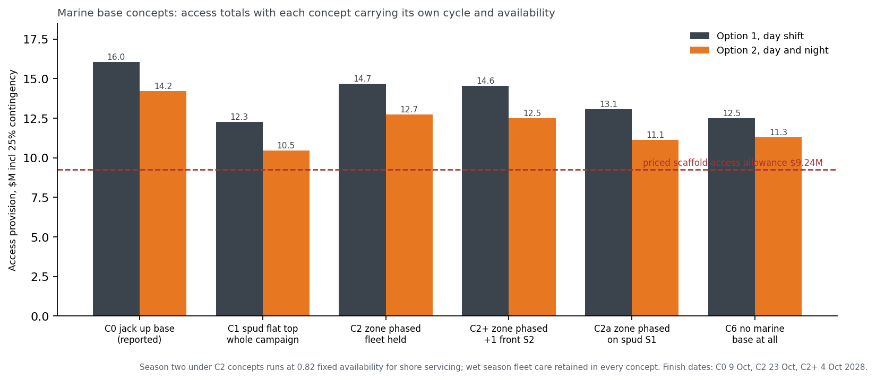
The marine base: six ways to buy it
Each concept carries its own cycle and availability. The zone phased case keeps the jack up at the wharf head through season one, then services from the deck in the shelter. Removing the base entirely saves $3.55M net and costs a front and 8 percent of every shift.
Commercial in confidence | Endura Decommissioning | ED-018-2026-03 | Rev B | 10

Slide 13
Your three questions from 21 August, answered
The connection
Winches connect to the concrete deck and kerb through anchor groups carrying forged lifting points, matching the STL precedent; nothing hangs from the steel. RPEQ design, independent check and proof load before the trial. Report Section 10.
The securing
Four braked hoists each under half rated load; positive ties once lifted, so the stage is fixed plant between moves. No single failure lowers a stage. Section 10.2.
The barge, with and without
Without: $12.49M, nine fronts, services on the roadway. With: 0.4 to 0.6 of a shift per bent returns to the tools; true net cost $2.1M to $2.8M. Section 9.2.
Commercial in confidence | Endura Decommissioning | ED-018-2026-03 | Rev B | 11

Slide 14
Decisions and dates
1. Instruct the proving trial
$350,000 to $600,000, needed within weeks for the September window. Commits the trial only. One week with the marine base, one without, so the barge question is settled by measurement.
2. Instruct the proving campaign
First bents of season one, at tender award. Commits one season’s mobilisation.
3. Fleet order on the measured cycle
Taken only after the trial collapses the eight to ten front range. The campaign commitment.
Also sought
The repair library principle; the written night and evening position; chart depths; the preferred base scenario before the workshop.
Commercial in confidence | Endura Decommissioning | ED-018-2026-03 | Rev B | 12

